Slide 1

WEB Development
Grade 7&8

Slide 2
Recap of the last Class
Notes:
Objective:
Review the previous lesson on Navigation
Introduce the new topic: Drop Down Menu.
Teacher Instructions:
Navbar:
Recap the purpose of a navbar and its importance in providing easy access to different sections of a website.
Emphasis on User Experience:
Discuss how a well-designed navbar improves user experience by making navigation intuitive and straightforward.
Explain how an intuitive navbar can help a website to grow by retaining users and encouraging them to explore more content.

Slide 3
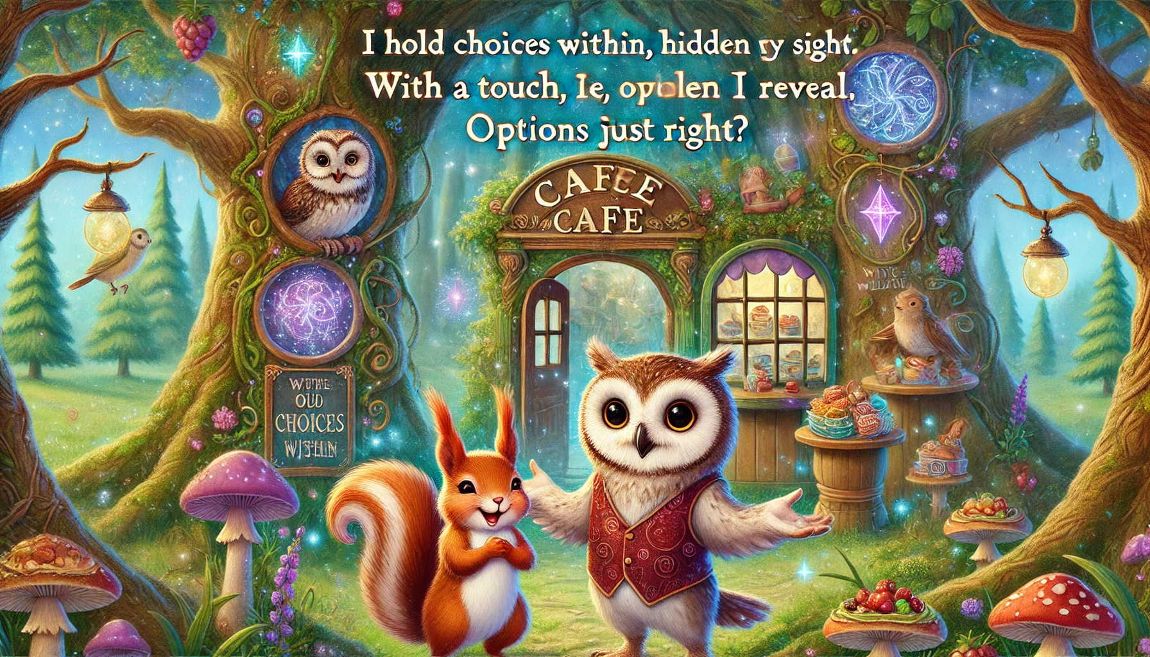
The Mystery of the Enchanted Forest Café
In the Enchanted Forest, Oliver the owl ran a magical café with a long, confusing menu. One day, Luna the squirrel had an idea to simplify it. They visited the Wise Willow, who gave them a riddle:
"I hold choices within,
Hidden from sight,
With a touch,
I reveal,
Options just right.
What am I?"
Notes:
Objective:
The answer is: A magic book. With this magic, Luna and Oliver could help customers find their favorite enchanted snacks easily.
Inform student to find the riddle answer in the picture
Objective:
To introduce students to the concept of dropdown menus through a fun and engaging story.
To develop problem-solving skills by solving a riddle related to the story.
To understand the practical use and importance of dropdown menus in website navigation.

Slide 4
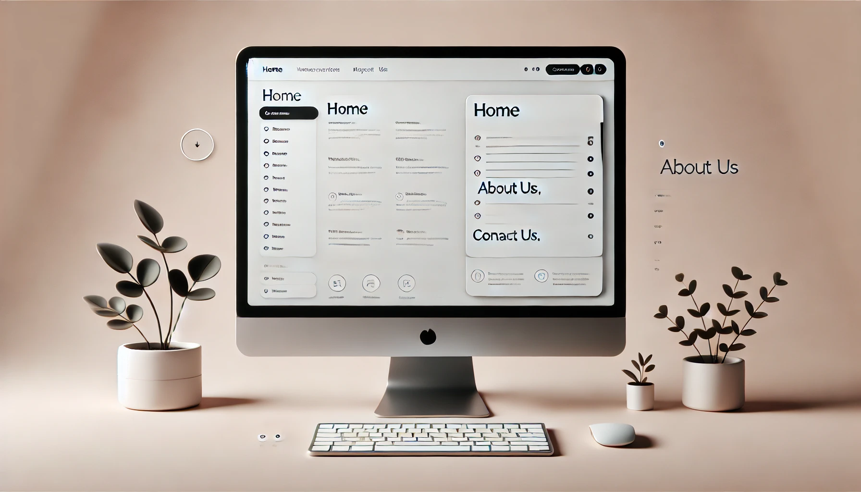
Introduction to Drop down menu
Notes:
Objective:
Introduce the concept of drop down menu
Learning Objectives:
Purpose: Understand that dropdown menus organize many options in a small space, making websites easier to navigate.
Components: Recognize the parts of a dropdown menu, including the main button and the list of options.
Usage: Explore how dropdown menus enhance user experience by providing easy access to different sections.
Creation: For older students, introduce the basics of creating a dropdown menu using HTML and CSS.

Slide 5
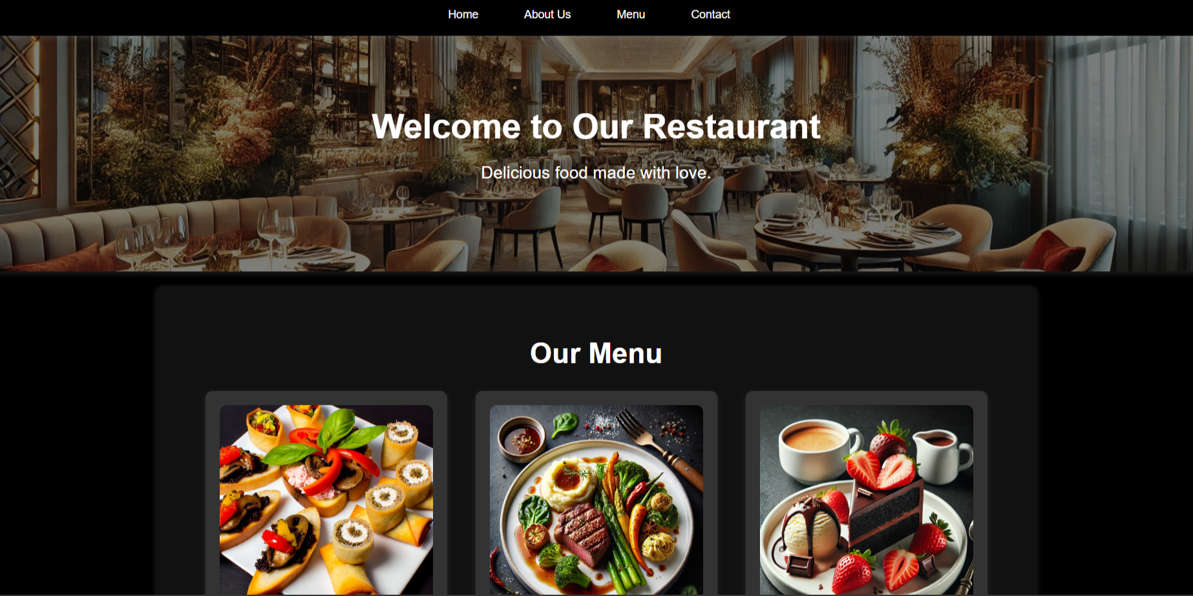
Project – Restaurant Menu
Notes:
Project Link: Restaurant Menu
Objective:
Present the final project example.
Teacher Instructions:
Show the Screenshot:
Display the screenshot of the final project example.
Show the Project in Live Action:
Demonstrate the project on a live website to show how it functions.
Navigate through the website to showcase the drop down menu in action.
Emphasize the importance of drop down menu.
Explain the Project:
Inform students that they will create a similar project.
Highlight the key features:
A clear and user-friendly drop down menu.
An engaging webpage.

Slide 6
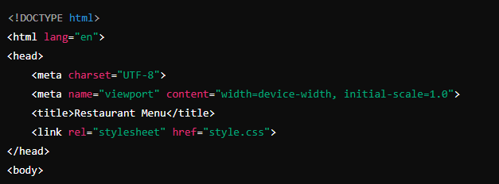
Working with the Project
HTML Code Explanation
Basic Structure of an HTML Document
Notes:
"Teacher's Activity"
Project Link: Restaurant Menu
Objective:
Explain the basic structure of an HTML document.
Teacher Instructions:
Display the screenshot of the HTML code.
Provide an overview of the basic code:
Code Explanation:
<!DOCTYPE html>: Declares the document type and version of HTML.
<html lang="en">: Root element with language attribute set to English.
<head>: Contains meta-information about the document.
<meta charset="UTF-8">: Sets character encoding to UTF-8.
<meta name="viewport" content="width=device-width, initial-scale=1.0">: Ensures the webpage is responsive.
<title>: Sets the title of the webpage.
<link rel="stylesheet" href="style.css">: Links the external CSS file for styling.

Slide 7
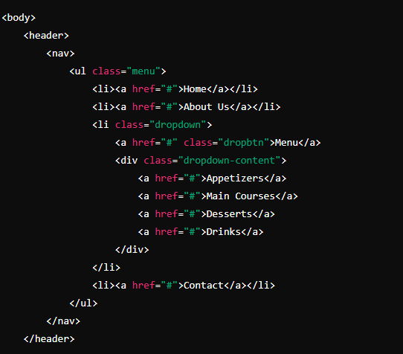
Working with the Project
Body and Navigation Structure
Notes:
Objective:
Project Link: Restaurant Menu
Teacher Instructions:
Show how the nav, ul and li tag are used to create the structure of a navigation bar .
Demonstrate the effective use of class selectors for customization of drop down menu.
Tag Explanation:
<body>: Contains the content of the webpage.
<header>: Defines the header section.
<nav>: Navigation bar for the website.
<ul class="menu">: Unordered list with a class of "menu" for styling.
<li><a href="#">Home</a></li>: List items with anchor tags for navigation.
<li class="dropdown">: List item with a class for dropdown functionality.
<a href="#" class="dropbtn">Menu</a>: Anchor tag styled as a dropdown button.
<div class="dropdown-content">: Container for dropdown menu items.

Slide 8
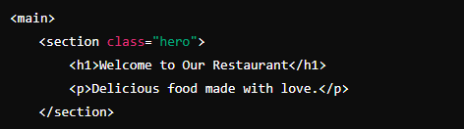
Main Content - Hero Section
Notes:
Objective:
Teacher Instructions:
Project Link: Restaurant Menu
Show how the hero section looks and functions on a live website.
Demonstrate the impact of a strong and appealing hero Section.
Tag Explanation:
<main>: Contains the main content of the webpage.
<section class="hero">: Defines a section with the class "hero" for styling.
<h1>Welcome to Our Restaurant</h1>: Heading inside the hero section.
<p>Delicious food made with love.</p>: Paragraph inside the hero section.

Slide 9
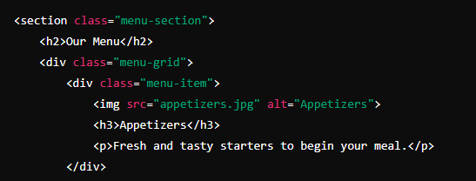
Main Content - Menu Section
Notes:
Objective:
Project Link: Restaurant Menu
Teacher Instructions:
Show how the menu section looks and functions on a live website.
Tag Explanation:
<section class="menu-section">: Defines a section with the class "menu-section" for styling.
<h2>Our Menu</h2>: Heading for the menu section.
<div class="menu-grid">: Container for menu items styled with a grid layout.
<div class="menu-item">: Defines an individual menu item.
<img src="appetizers.jpg" alt="Appetizers">: Image for the menu item.
<h3>Appetizers</h3>: Heading for the menu item.
<p>Fresh and tasty starters to begin your meal.</p>: Description of the menu item.

Slide 10
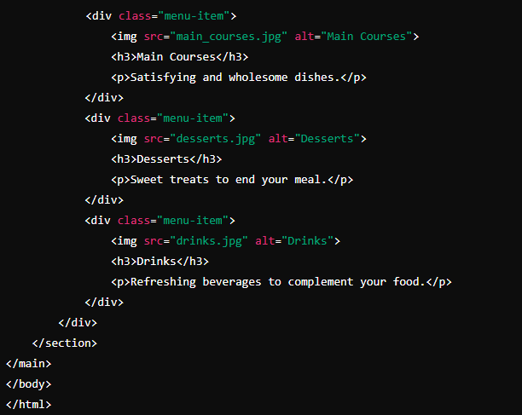
Main Content - More Menu Items
Notes:
Objective:
Project Link: Restaurant Menu
Teacher Instructions:
Show how the menu section looks and functions on a live website.
Tag Explanation:
<div class="menu-item">: Defines additional menu items.
<img src="main_courses.jpg" alt="Main Courses">: Image for the main courses menu item.
<h3>Main Courses</h3>: Heading for the main courses menu item.
<p>Satisfying and wholesome dishes.</p>: Description of the main courses menu item.
<img src="desserts.jpg" alt="Desserts">: Image for the desserts menu item.
<h3>Desserts</h3>: Heading for the desserts menu item.
<p>Sweet treats to end your meal.</p>: Description of the desserts menu item.
<img src="drinks.jpg" alt="Drinks">: Image for the drinks menu item.
<h3>Drinks</h3>: Heading for the drinks menu item.
<p>Refreshing beverages to complement your food.</p>: Description of the drinks menu item.
</div></div></section></main></body></html>: Closing tags for the grid, sections, main content, body, and HTML document.

Slide 11
Html Structure Done
Let's Style it Now
Notes:
Objective:
Review the code till now
Teacher Instructions:
Recap the key points.
Encourage interactive discussion and exploration of tags like nav, ul, li, a, div.

Slide 12
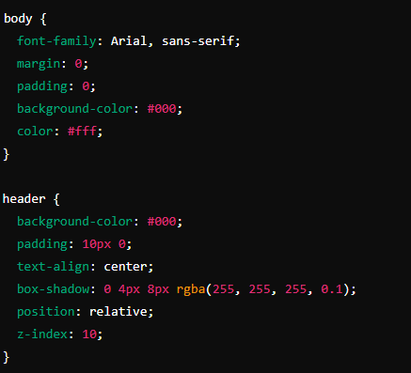
Working with the Project
CSS Code Explanation:
Body and Header Styling:
Notes:
Objective:
Project Link: Restaurant Menu
Explain body and header Styles:
Teacher Instructions:
Display the screenshot of the CSS code.
Explain the styling for the body and header:
body: Styles the entire webpage body.
font-family: Sets the font to Arial and falls back to sans-serif if Arial is unavailable.
margin: Removes default margin from the body.
padding: Removes default padding from the body.
background-color: Sets the background color to black.
color: Sets the text color to white.
header: Styles the header section.
background-color: Sets the background color to black.
padding: Adds padding of 10 pixels on the top and bottom.
text-align: Centers the text inside the header.
box-shadow: Adds a shadow effect with specified offset (0 horizontal, 4px vertical), blur (8px), and color (semi-transparent white).
position: Sets the position to relative, ensuring the header has its own stacking context.
z-index: Ensures the header is above other elements by setting a stacking order of 10

Slide 13
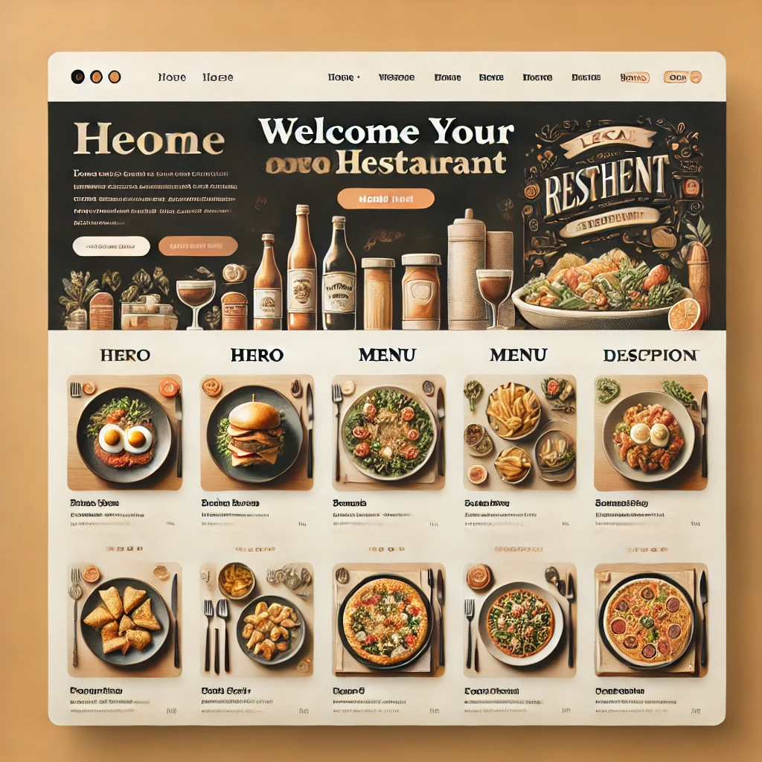
Now it's your turn!
Task:
try to add one more menu items in the menu content section
Instructions: Share the code with others and work as a group to give your own personalization to the final web page.
Notes:
"Students' Activity"
Students will expand the "Our Menu" section of their restaurant website by adding more menu items.
Teacher Instructions:
Present the Task:
Explain that students will create and expand an "Our Menu" section on their website.
Instruct Students to Complete the Activity:
Use HTML and CSS skills to build and style this section.
Add more menu items, such as Breakfast, Salads, and Sides.
Discuss the Importance of Presentation:
Explain how a visually appealing menu enhances customer experience.
Provide Discussion Points:
Appetizers: Fresh starters to begin the meal.
Main Courses: Satisfying and wholesome dishes.
Desserts: Sweet treats to end the meal.
Drinks: Refreshing beverages.
Breakfast: Delicious options to start the day.
Salads: Healthy and fresh choices.
Sides: Complementary dishes for the main courses.

Slide 14

How to Save & Share the project.
Replit offers autosave option – so not worry about the same.
To share project with someone in view mode: just copy the link from the URL bar, and share the link
To share the project for collaboration
Click on "Invite" from the top right corner
If you know the username, type it in the box and click on invite
You can also turn on the toggle button "private join link" to create a public collaboration link and invite members to edit your code.
Notes:
Instructions for the Teacher:
Explain how to save and share projects on Replit, including the options for collaboration.
Emphasize the importance of sharing projects for feedback and collaboration.

Slide 15


Which attribute sets the character encoding for the HTML document?
A) lang
B) charset
C) viewport
D) title
Notes:
Answer: B) charset

Slide 16
What does the font-family property do?
A) Sets the size of the font
B) Changes the text color
C) Specifies the font to be used for the text
D) Aligns the text
Notes:
Answer: C) Specifies the font to be used for the text

Slide 17
How do you remove default margin and padding in CSS?
A) margin: auto; padding: auto;
B) margin: 0; padding: 0;
C) margin: none; padding: none;
D) margin: 10px; padding: 10px;
Notes:
Answer: B) margin: 0; padding: 0;

Slide 18
What HTML element is used to create a navigation bar?
A) <nav>
B) <menu>
C) <ul>
D) <div>
Notes:
Answer: A) <nav>

Slide 19

What have we learnt?
What We Learned Today:
HTML Document Structure:
Tags Covered: <!DOCTYPE html>, <html>, <head>, <meta>, <title>, <link>, <body>
Header and Navigation:
Tags Covered: <header>, <nav>, <ul>, <li>, <a>, <div>
Basic CSS Styling:
Properties Covered: font-family, margin, padding, background-color, color, text-align, box-shadow, display, list-style-type, text-decoration, hover
Notes:
Objective:
Summarize the key learnings from the lesson.
Teacher Instructions:
Review the tags and properties
Ask the student to explain the tags and properties one by one
Details: Discussed the basic structure of an HTML document. Explained the importance of the <!DOCTYPE html> declaration. Introduced the <html> element with the lang attribute for specifying the language. Covered the <head> section, including the <meta charset="UTF-8"> for character encoding, the <meta name="viewport" content="width=device-width, initial-scale=1.0"> for responsive design, the <title> for setting the page title, and the <link rel="stylesheet" href="style.css"> for linking the CSS file.
Details: Created a header using the <header> tag and a navigation bar using the <nav> tag. Built an unordered list (<ul>) with list items (<li>) to create navigation links (<a>). Implemented a dropdown menu by using a <div> element within the list item for additional navigation options.
Details: Applied basic CSS styles to enhance the webpage's appearance. Set the font-family to Arial with a fallback to sans-serif. Removed default margin and padding for the body. Set the background-color to black and color to white for text. Styled the header with padding, text-align, and a box-shadow for a shadow effect. Styled the navigation bar by setting the list items (<li>) to display: inline-block and adding hover effects to the links (<a>).

Slide 20
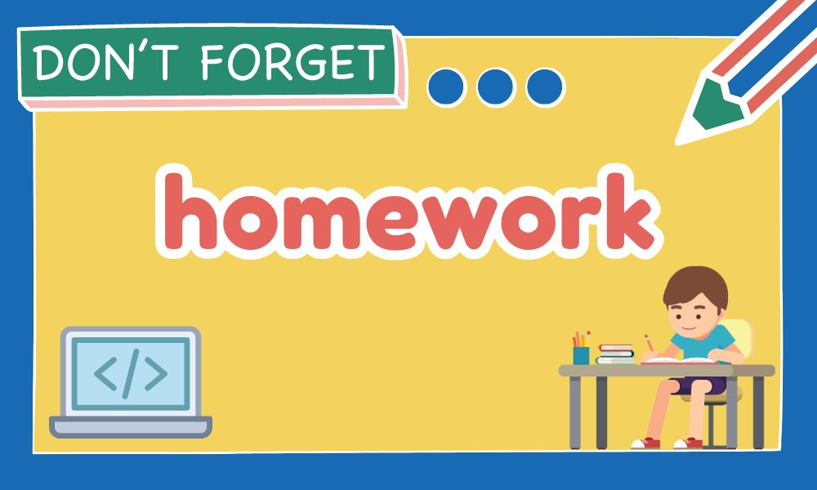
Homework Discussion
Notes:
Instructions for the Teacher: Facilitate a discussion about the homework assignment.

Slide 21
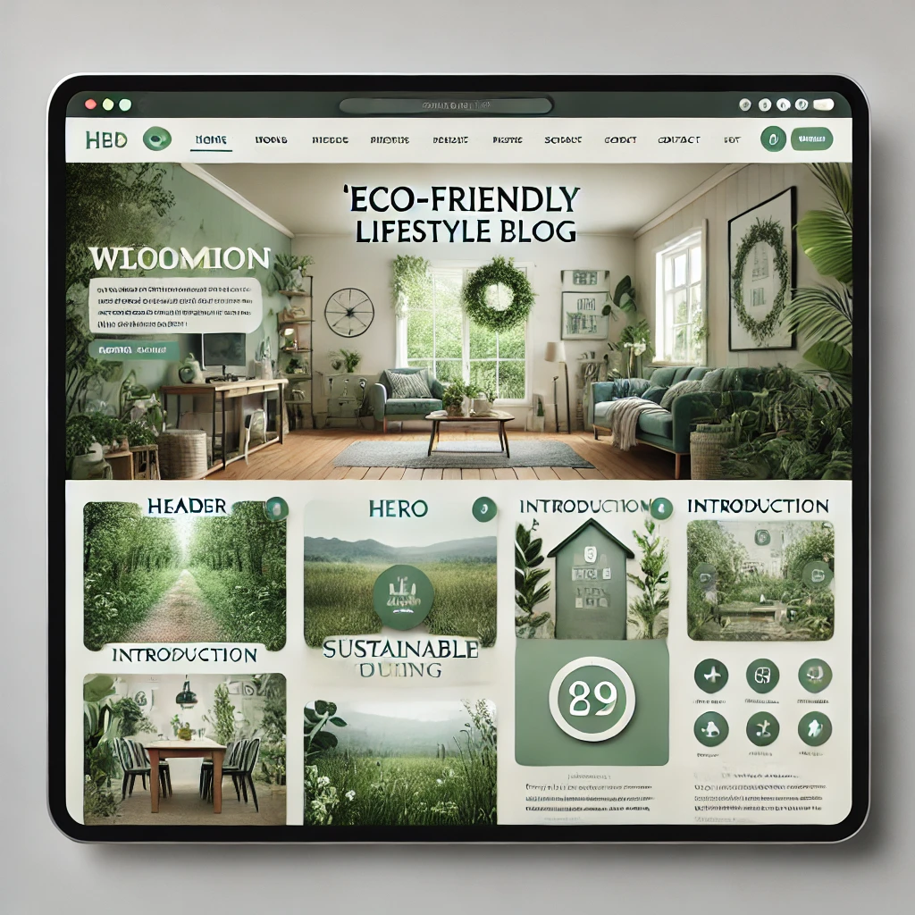
Brain Booster Bonus
Create a Responsive Footer
Enhance Restaurant look by adding a Create a Responsive Footer
Notes:
Objective: Instruct the student to create responsive footer and share with each other on next class

Slide 22

Be Skeptical of Promises
If something online sounds too good to be true, like 'free games for life,' it could be a trick.
Oliver saw an ad online promising "free games for life" and eagerly clicked on it, hoping for a great deal.
Instead, his computer got infected with malware, causing a lot of problems.
The moral of the story: don't believe ads or emails promising free stuff without checking with an adult first, as it could be a trick.

